Slide 1
MEAN STACK DEVELOPER
CAPSTONE PROJECT
Team Panthers

Slide 2
Team Panthers
Harshvardhan Sawal : Shopping Cart (Frontend, core functionalities), Forms data validations, UI/UX components, Integration Testing, Github Kanban Dashboard
Ian Haynes : Backend, Ticketing(User and Employee), requests(Employee and Admin), Update Product
Kranthi Kumar Reddy Anugu : Login and SignUp page functionalities, Documentation
Miguel Valdez : AWS deployment, Backend, Update profile, Employee order status, Generate Reports, Github Kanban Dashboard
Lipi Boreddy : Frontend components, Presentation, Documentation, Edge Case testing

Slide 3
Functionality
We developed a dynamic website for online purchase of groceries with three main users for this application
ADMIN : As an admin, after successful login he/she has different functionalities like Add Products, Update Products, Delete Products, View Requests etc
USER: Users can login with existing details or create an account by clicking in signup
EMPLOYEE: The employee can sign-in entering the login credentials like email and password and have functionalities like Send Request,Update Order, Unlock Users etc

Slide 4
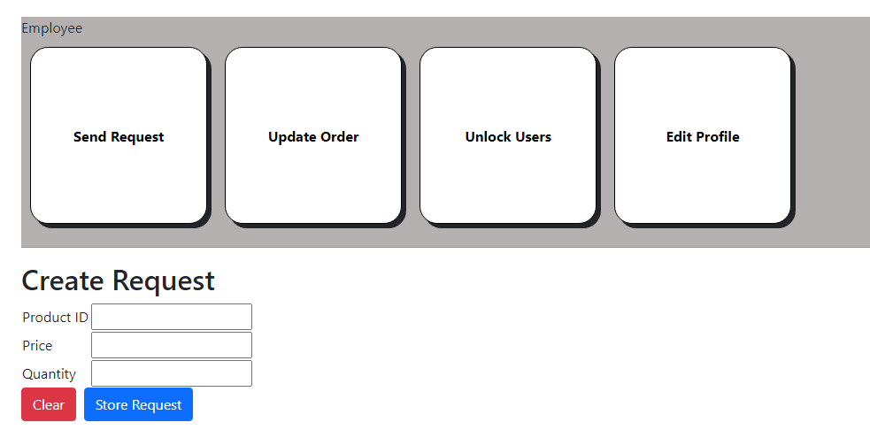
Demo
This is how our Employee Dashboard screen looks like

Slide 5
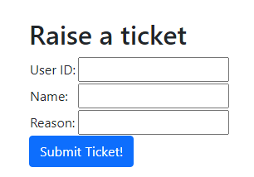
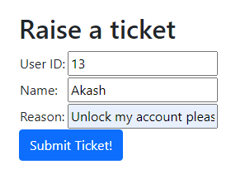
Demo
User raises a ticket to unlock accout

Slide 6
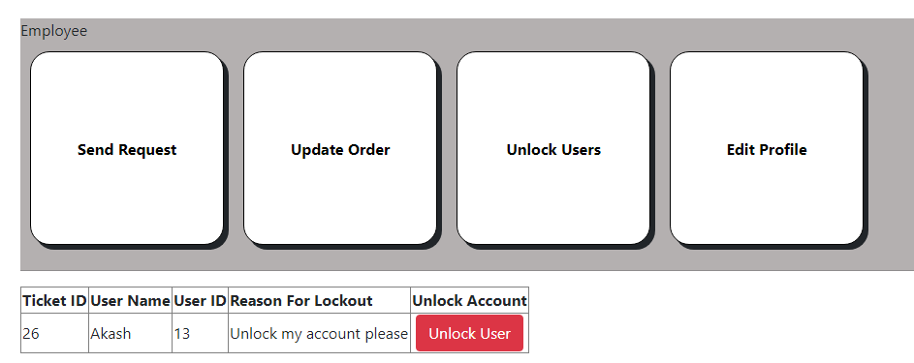
Demo
This is how our Employee Dashboard screen looks like

Slide 7

Challenges faced
Communication is a challenge for a virtual team as we didn’t have the opportunity to interact with eachother as frequently as a co-located team could.
We overcame this challenge by communicating with team members more often and by creating a Kanban board and Github to keep track of the tasks completed and yet to complete.

Slide 8


Conclusion
We used Angular, Nodejs, MongoDB, Expressjs, Typescript, Bootstrap and AWS cloud for this application
We successfully designed the website with full functionality.

